Slide 1
How Competency Education is Changing Higher Education
Presented by:
Patricia A. Lynott, Ph.D.
Provost & Senior Vice President of Academic Affairs
Southern New Hampshire University

Slide 2



Slide 3
Agenda
Definition of competency-based education and how it works
Why competency-based education is attracting so much interest from policy makers and potential students
How colleges that are organized on traditional methods of awarding credit can explore competency-based offerings and get them off the ground
Question and answer period
Suggested readings for further exploration of competency-based education

Slide 4
Origin & Timeline of SNHU
1932: Shapiro Family establishes the New Hampshire School of Accounting and Secretarial Science.
1961: The school was incorporated and renamed the New Hampshire College of Accounting and Commerce.
1963: The State of New Hampshire granted the college its charter, giving it degree-granting authority.
1968: The college became a non-profit institution under a board of trustees.
1969: The college was renamed New Hampshire College

Slide 5
Origin & Timeline of SNHU
1995: New Hampshire College established a “distance-ed” program which was the foundation of what is now SNHU’s College of Online and Continuing Education (COCE).
2001: New Hampshire College became Southern New Hampshire University.
Today: SNHU is a private, comprehensive university serving over 35,000 students. We award the associate’s, bachelor’s, master’s, and doctoral (Ph.D. and Ed.D.) degrees.

Slide 6
SNHU’s Three Colleges
Southern New Hampshire University
University College (UC)
College of Online & Continuing Education (COCE)
College for America (CfA)

Slide 7
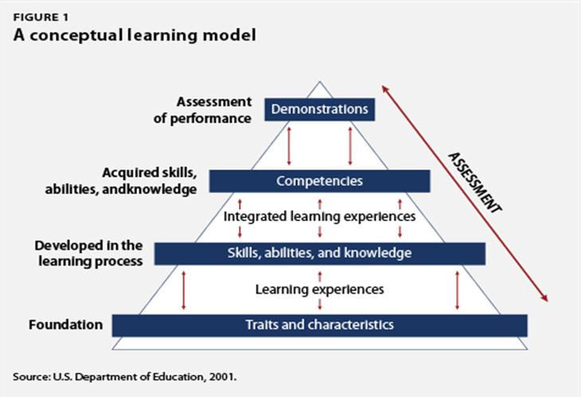
Competency-based Education Defined
What is competency-based education and how does it work?

Slide 8
Competency-based Education Defined
Federal definition of direct assessment competency-based programs:
  A direct assessment program is an instructional program that, in lieu of credit hours or clock hours as a measure of student learning, utilizes direct assessment of student learning, or recognizes the direct assessment of student learning by others.

Slide 9
SNHU’s Competency-based Programs
Southern New Hampshire University
University College (UC)
College of Online & Continuing Education (COCE)
College for America (CfA)
3YHonors Program:
BS in Business
Administration
AS in General Studies

Slide 10
National Interest in
Competency-based Education
Why is competency-based education attracting so much interest from policy makers and potential students?

Slide 11
Launching Competency-based Education
How can colleges that are organized on traditional methods of awarding credit can explore competency-based offerings and get them off the ground?

Slide 12
Suggested Reading
AAC&U. (2011). AAC&U statement on the Lumina Foundation for Education's Proposed Degree a Qualifications Profile. Retrieved from http://www.aacu.org/about/statements/documents/lumina_dqs_2011.pdf
Alexander, L. (2009, October 26). Why college should take only three years. Newsweek, 26-29.
Archibald, R. B., & Feldman, D.H. (2010). Why does college cost so much? New York, NY: Oxford University Press.
Arum, R., & Roksa, J. (2011). Academically adrift: Limited learning on college campuses. Chicago: University of Chicago Press.
Bradley, M., &Painchaud, S. (2009). Innovation in higher education at Southern New Hampshire University: The design, development, and success of a three year honors curriculum in business administration. In Proceedings of the 14th Annual Conference (pp. 29-47). Athens, Greece: European Council of Business Education.

Slide 13
Suggested Reading
Cambridge, D. (2010). Eportfolios for lifelong learning and assessment. San Francisco, C.A: Jossey-Bass.
Cohen, A. M., & Kisker, C. B. (2010). The shaping of American higher education: Emergence and growth of the contemporary system (2nd Ed.). San Francisco, CA: Jossey-Bass.
Fain, Paul. 2013. "Rose of Customized Learning." Inside Higher Ed (http://www.insidehighered.com/news/2013/03/05/competency-based-education-continues-spread[November 2013]).
Fischer, K. (2011, May 15). Crisis of confidence threatens colleges. The Chronicle of Higher Education. Retrieved from http://chronicle.com/article/Higher-Education-in-America-a/127530/?sid=at&utm_source=at&utm-medium=en.
Kamenetz, Anya, October 29, 2013. "Are You Competent? Prove It." The New York Times. http://www.nytimes.com/2013/11/03/education/end life/degrees-based-on-what-you-can-do

Slide 14
Suggested Reading
Klein-Collins, Rebecca and Elizabeth Baylor, "Meeting Students Where They Are: Profiles of Students in Competency-Based Degree Programs," A Publication of the Center for American Progress and the Council for Adult and Experiential Learning. November 2013.
Knapp, L. G., Kelly-Reid, J. E., & Ginder, S. A. (2010). Postsecondary institutions and price of attendance in the United States: Fall 2009, degrees and other awards conferred: 2008-09, and 12-month enrollment: 2008-09 (NCES 2010-161). U.S. Department of Education. Washington, DC: National Center for Education statistics. Retrieved from http://nces.ed.gov/pubs2010/2010161.pdf
Laitinen, Amy. 2012. "Cracking the Credit Hour." New York: New America Foundation and Education Sector (http://higheredwatch.newamerica.net.sites/newamerica.net/files/policy docs/Cracking_the_Credit_Hour_Sept5_0.pdf).
LeBlanc, Paul J. 2013. "Thinking about Accreditation in a Rapidly Changing World." EDUCAUSE Review 48 (2) (http://www.educause.edu/ero/article/thinking-about-accreditation-rapidly-changing-world).
Lumina Foundation for Education. (2011, January). The degree qualifications profile. Retrieved from http://www.luminafoundation.org/publications/The_Degree_Qualifications_Profile.pdf
Neem, Johann N. "Experience Matters: Why Competency-Based Education Will Not Replace Seat Time," Liberal Education, Vol. 99, No. 4, Fall 2013, pp. 26-29.
Walvoord, B. E. (2010). Assessment clear and simple: A practical guide for institutions, departments, and general education (2nd Ed.). San Francisco, CA: Jossey-Bass.

Slide 15
Contact Information
Patricia A. Lynott, Ph.D.
p.lynott@snhu.edu
603.645.9695

